Slide 1
University Management System
Presented by:
Bhakti Daundkar(251)
Sumit Shelke(247)

Slide 2
Content
Introduction
Objective
Requirement Specification
E-R Diagram
Implementation
Conclusion

Slide 3
Introduction
UNIVERSITY MANAGEMENT SYSTEM (UMS) is Easy Solution which covers all aspects of Universities, Colleges or Schools.
UMS covers every minute aspects of a universities work flow and integrates all processes with user friendly interface. UMS is first choice of several state, governments/semi- government universities and institutions.
UMS take care of following department:
Fees Department
Examination Department
Faculty information portal
Student information portal

Slide 4
Objective
To make self-service systems with simple to use
Elimination of duplicate data entry processes.
To make automation of all the Academic / Examination / Administration operations.
To make ease and accuracy of reporting.

Slide 5
Requirement Specification
Hardware requirement
Processor Type: Core i3
Processor Speed: 2GHz
RAM Size: 2GB
Memory Technology: DDR3
Software requirement
Operating system: Windows 10
Application server: JAVA(NetBeans)
Connectivity: JDBC Driver

Slide 6
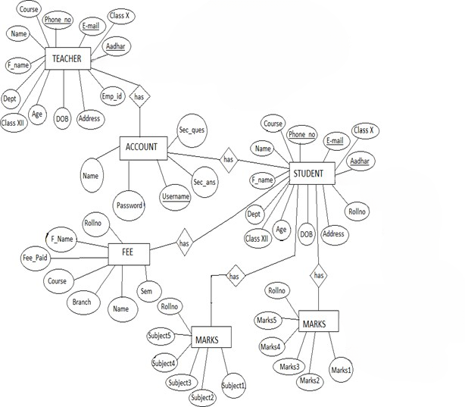
E-R Diagram

Slide 7
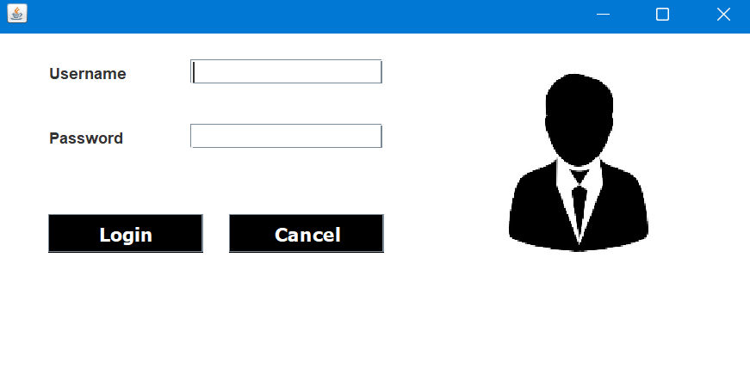
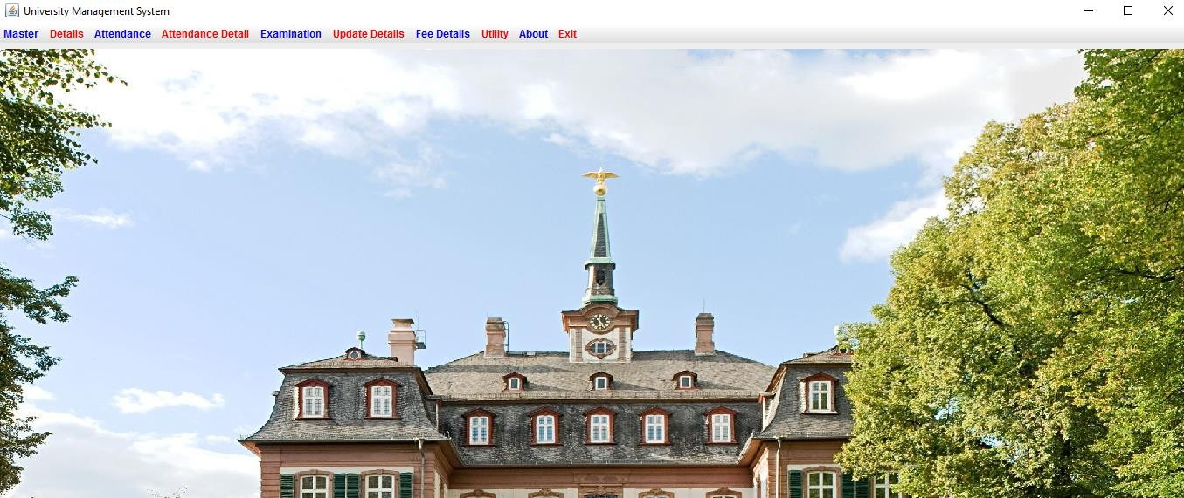
Implementation
Admin Login
Home Page

Slide 8
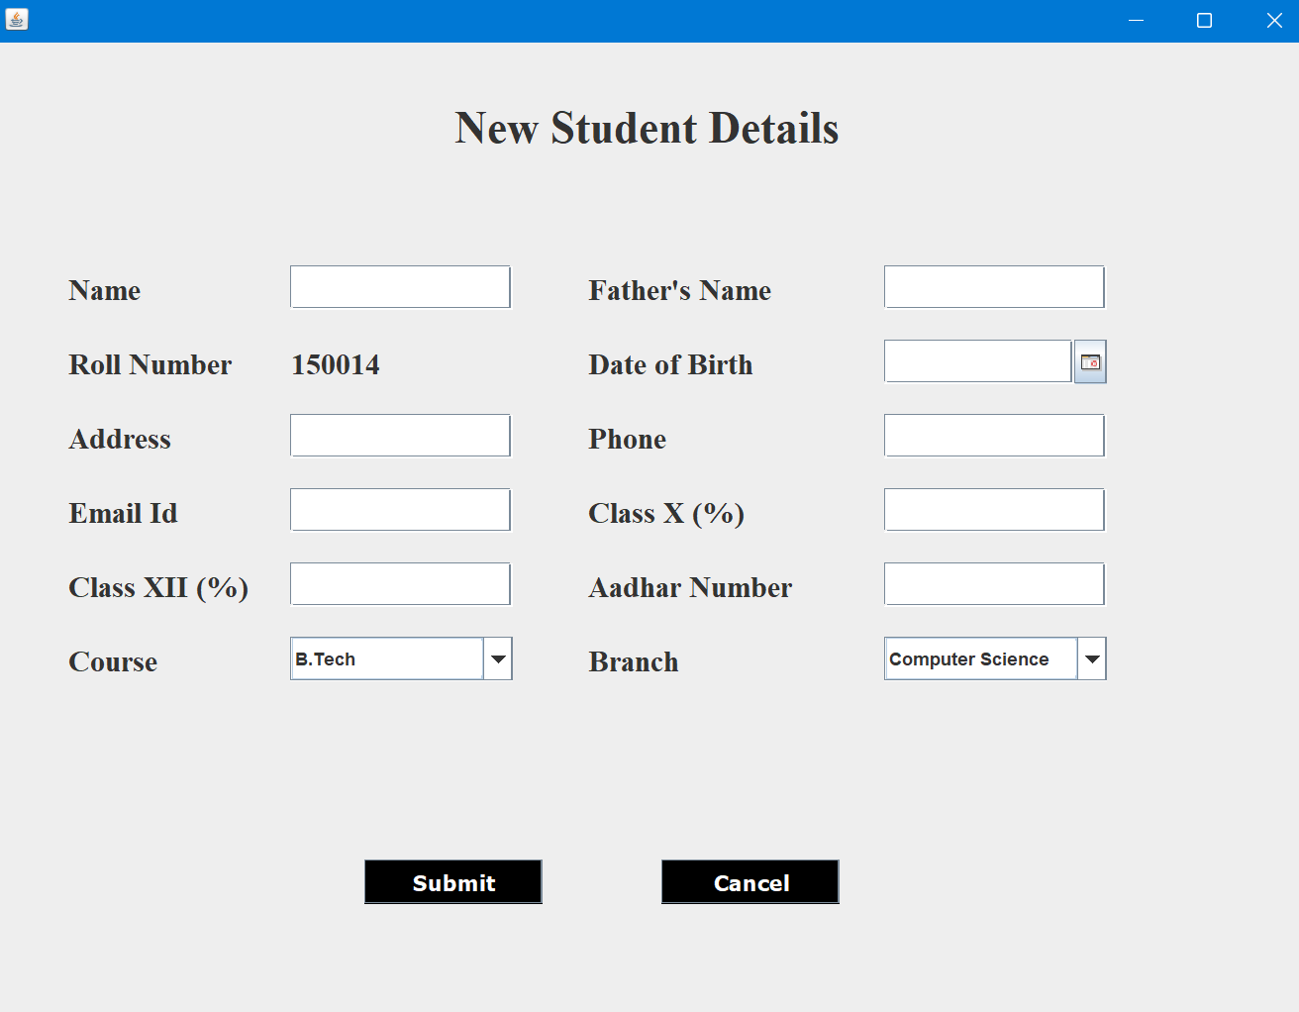
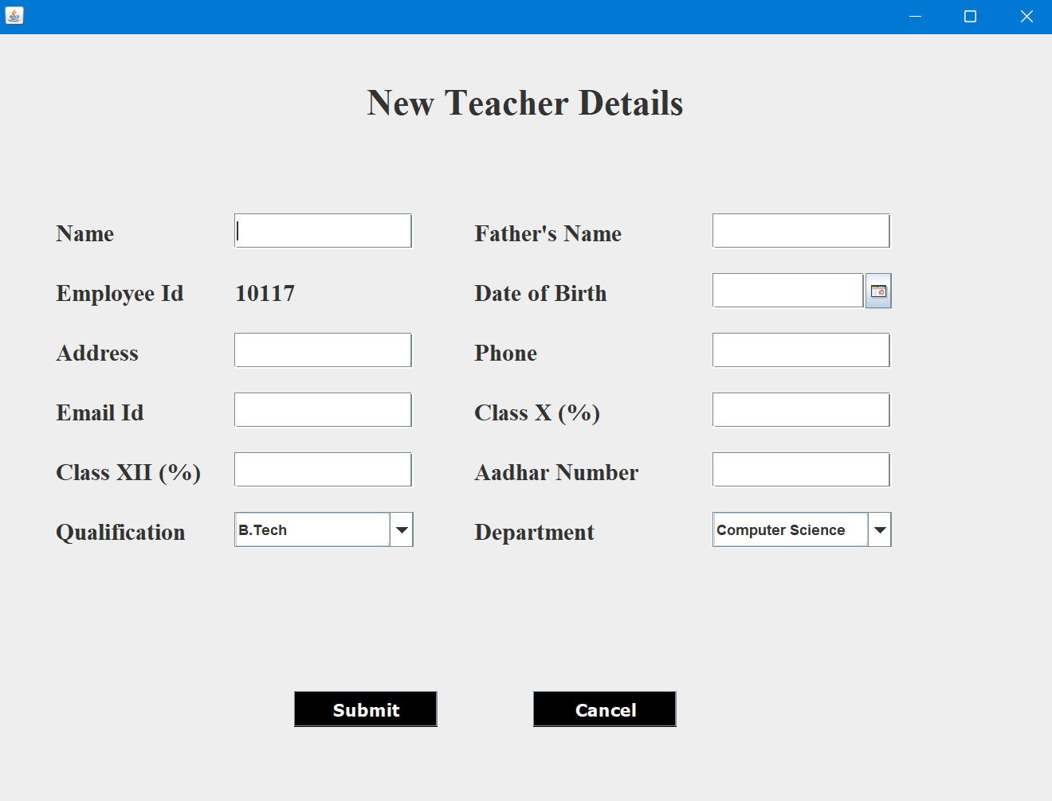
Student form
Teacher form

Slide 9
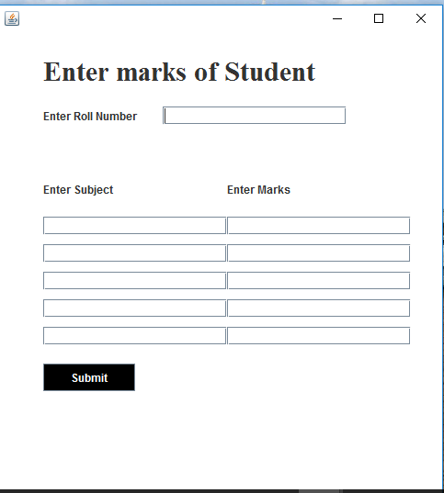
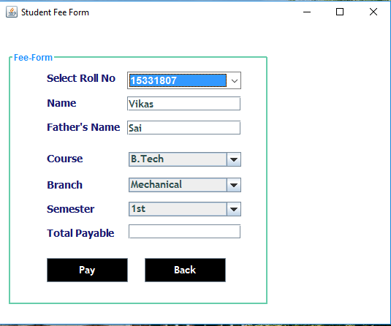
Mark & Subject
Fees form

Slide 10
Conclusion
The university management system developed in Java provides an efficient and effective solution for managing various tasks and processes within a university.
The system includes features such as student registration, faculty management, and Result.
The implementation of the system adheres to object-oriented programming principles and utilizes various Java technologies such as JDBC for database connectivity.
Deployment of our application will certainly help the college to reduce unnecessary wastage of time in personally going to each department for some information.

Slide 11
THANK YOU!!!

